Slide 1
Introduction to Django
Dr. Navneet Kaur

Slide 2
What is Django framework?
Django is an extremely popular and fully featured server-side web framework, written in Python.
It is a high-level web framework that enables rapid development of secure and maintainable websites.
It follows the model–view–template (MVT) architectural pattern.
It is maintained by the Django Software Foundation (DSF), an independent organization established in the US.

Slide 3
What is Django framework?
Django originated in 2003 as an internal project initiated by Adrian Holovaty and Simon Willison.
The first version of Django was released in July 2005.

Slide 4
MVT architecture
Model
View
Template

Slide 5
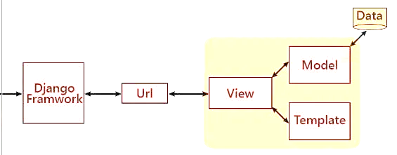
Key components of Django

Slide 6
Key components of Django
Model
View
Template
URL Dispatcher
Admin Interface
Forms
Authentication and Authorization

Slide 7
Advantages of Django
Batteries-Included Approach
Security
Scalability
Community and Documentation
Maintainability and Reusability
Admin Interface

